Slide 1
The Future of DX
Robert W. Schmieder KK6EK
International DX Convention
Visalia, CA
23 April 2017

Slide 2
DX IS STILL A THING!

Slide 3
Entities…

Slide 4
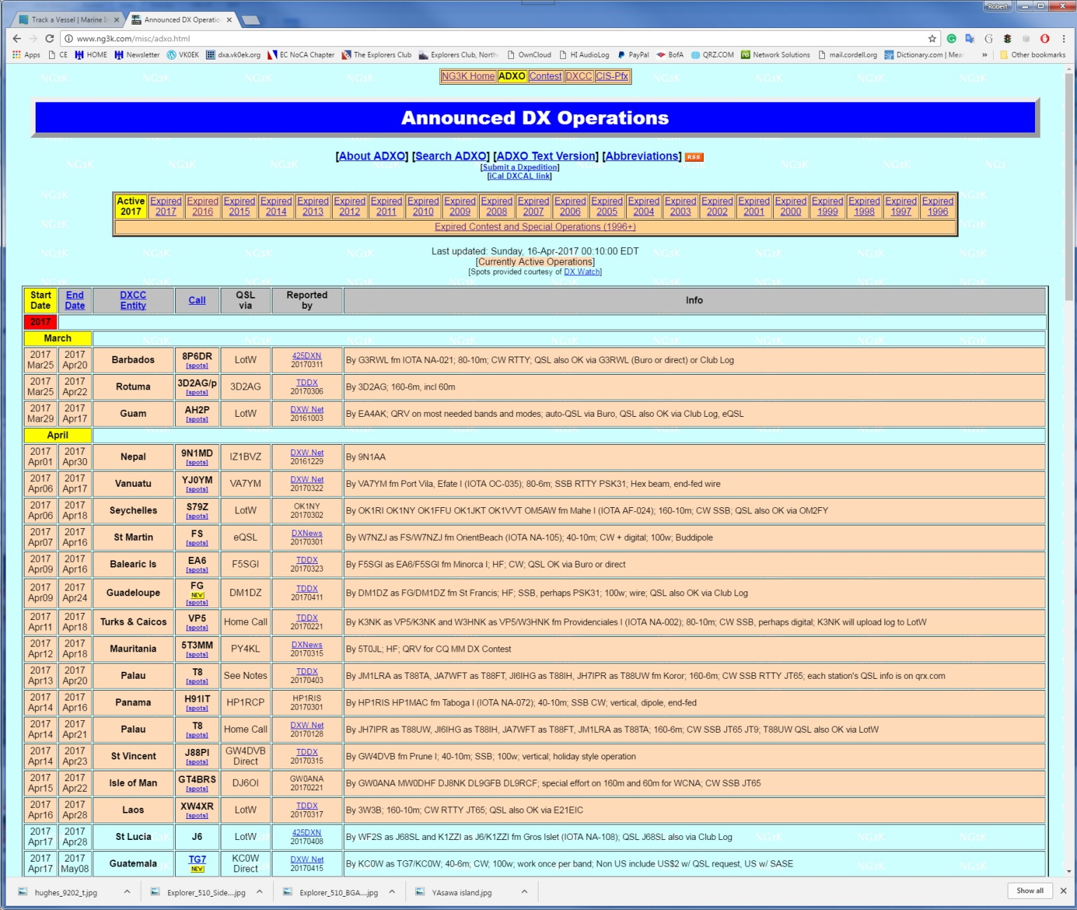
DXpeditions…

Slide 5
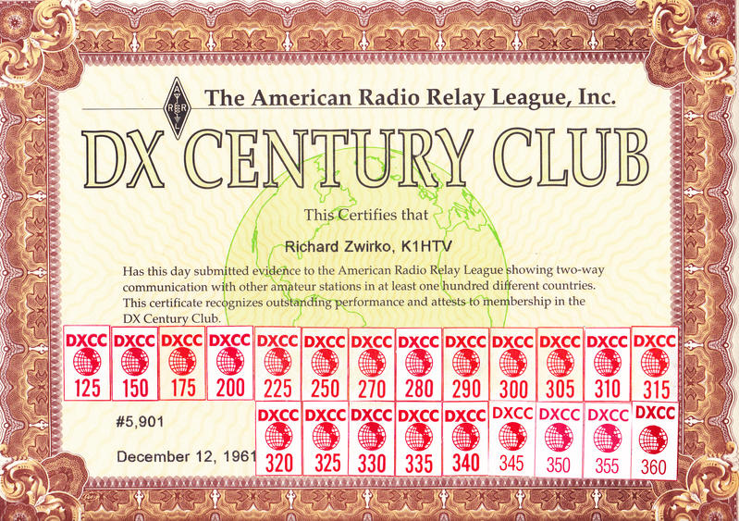
DXers…

Slide 6
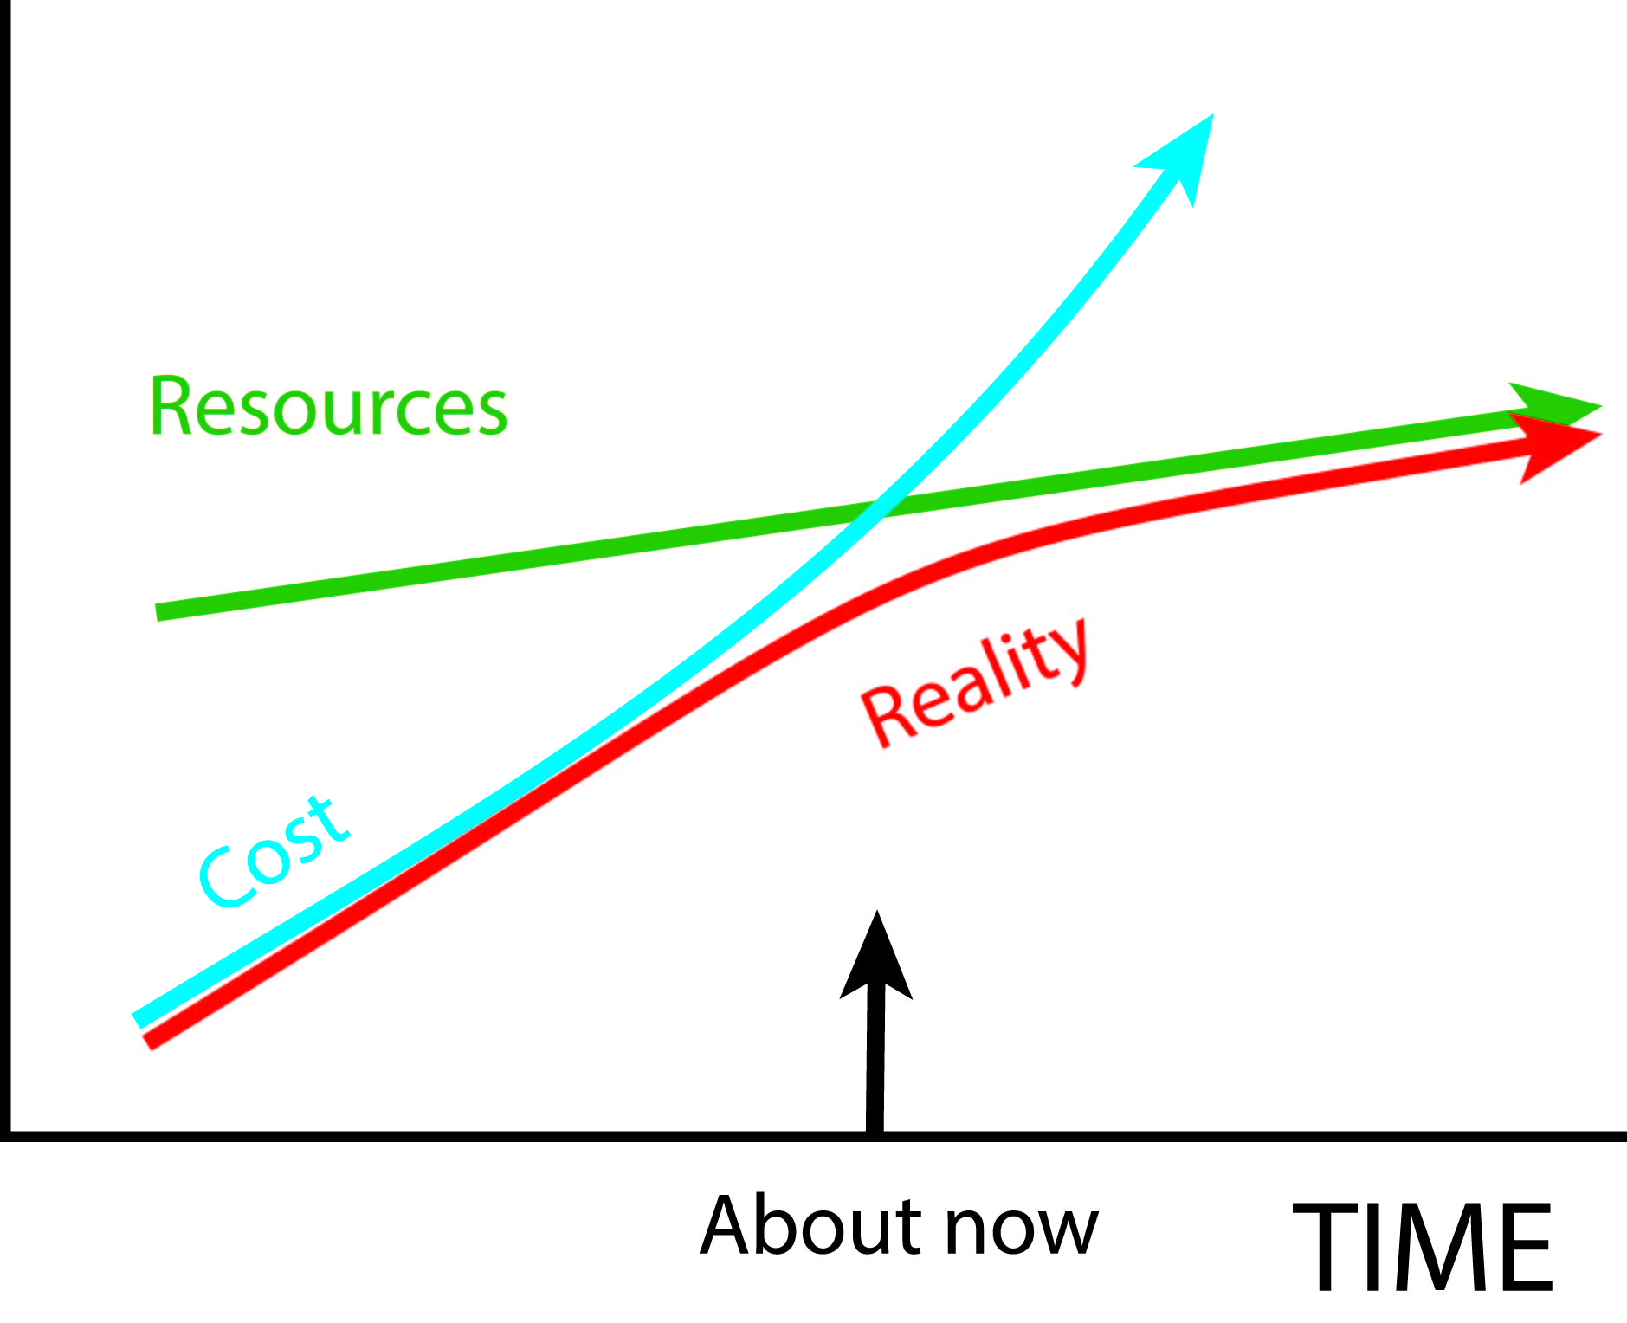
But we’re all aware that…
…there’s a problem on the horizon

Slide 7
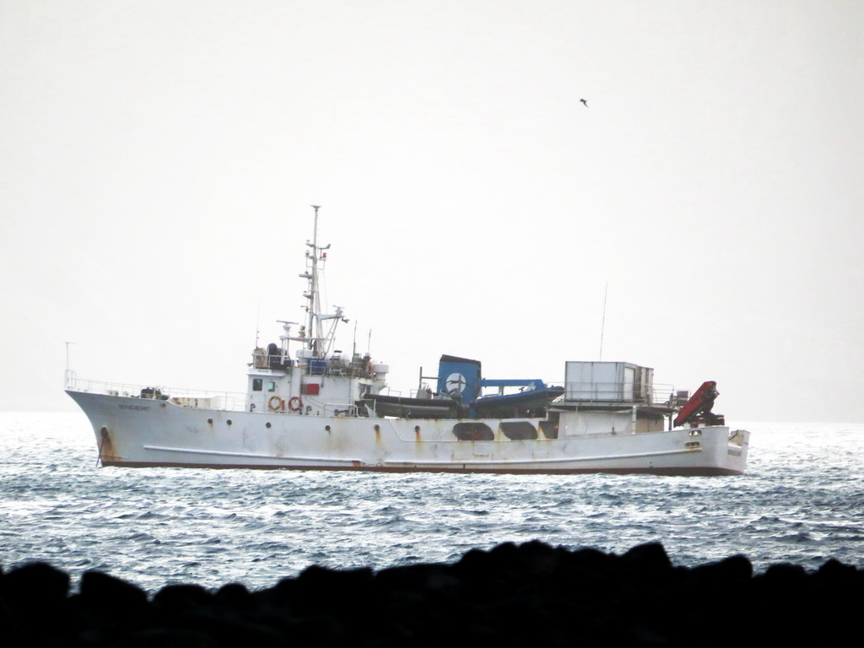
Cost of transportation has increased
Charge per person-day
1995 $250
2015 $500

Slide 8
The DX community has a limit…
The limit of DX resources
Radio Foundations $100k
Radio Clubs $20k
Radio Sponsors $100k
Grants $20k
Individuals $100k
QSLs $100k
TOTAL Radio Community $440k
TOTAL (potential)
$710k
Potential outside of DX Community
Non-Radio Sponsors $100k
Angels $100k
Non-Radio Grants $20k
Goal Sharing $50k
TOTAL Potential $270k

Slide 9
Options
Fall back to 20th Century practice
Continue unchanged
Grow in size and budget
Evolve technology
Change program goals
Separate into subActivities
Lose interest in DX
Introduce a new paradigm
ü

Slide 10
My view of the evolution of DX
DX is Still a Thing!
Phase 0 DX IS!
Phase 1 Internet
Phase 2 Real-time
Phase 3 Social Media
Phase 4 Systems
Phase 5 SET
Your Part in DX of the Future

Slide 11
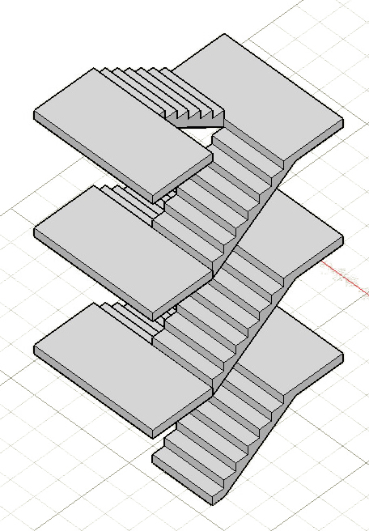
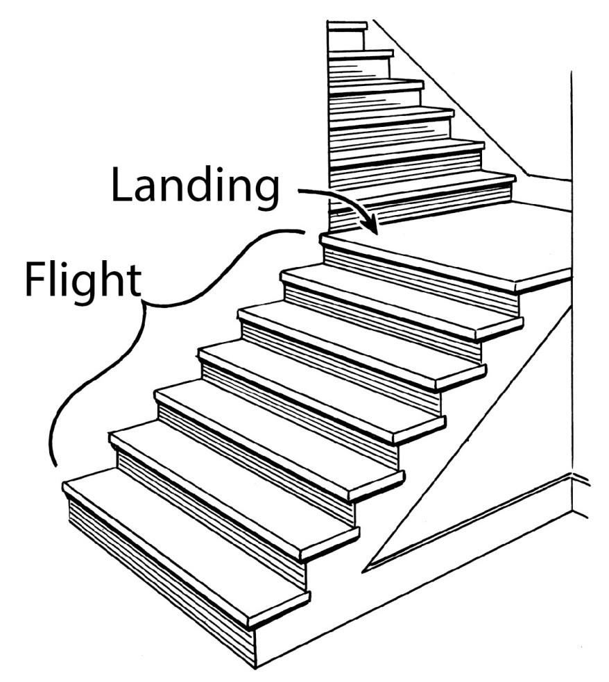
DX has evolved like flights of stairs
Each flight is followed by a landing, then another flight

Slide 12
PHASE 0 1915-1995 DX IS!
0

Slide 13
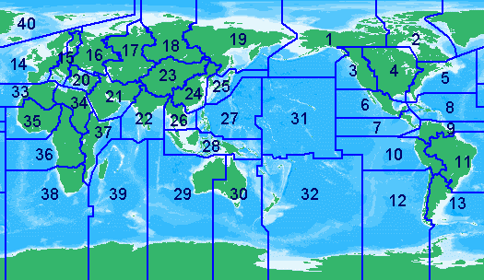
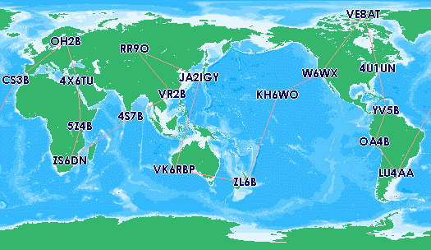
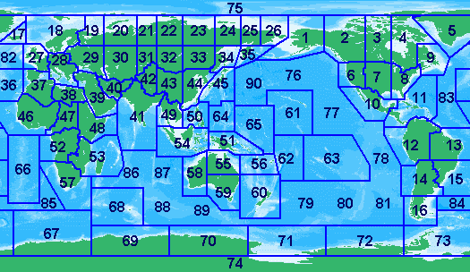
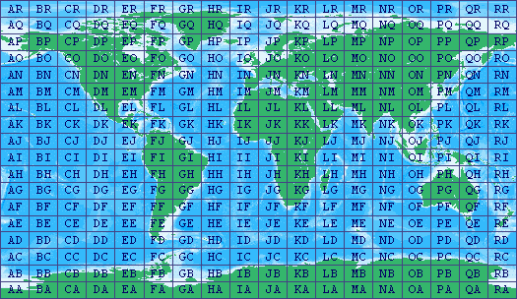
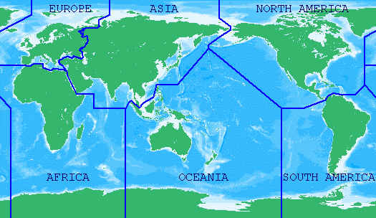
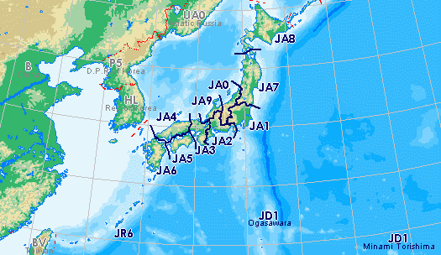
Dxing and DXpeditioning have matured

Slide 14
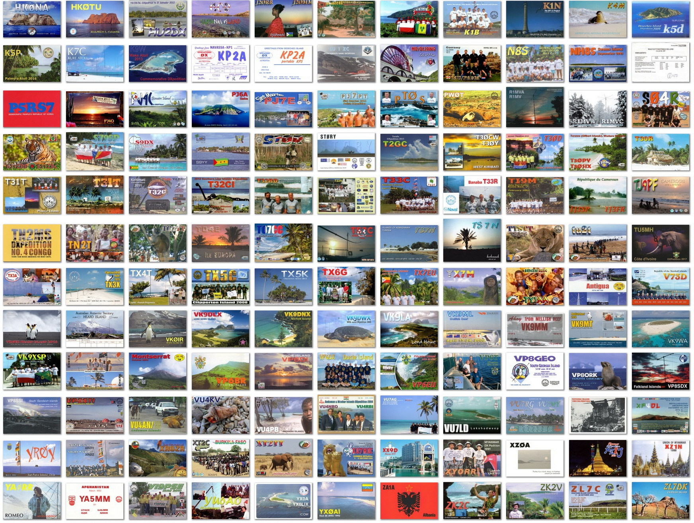

Slide 15
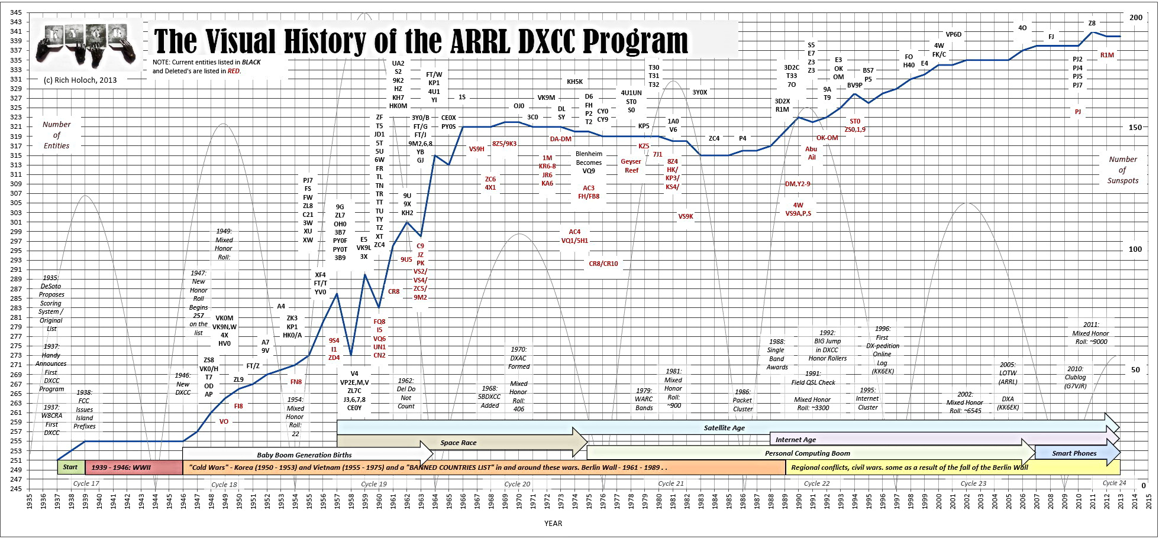
The Phases of DX
0
DX IS
Graphic: Rich KY6R

Slide 16
PHASE 1 1995-2005 INTERNET
1

Slide 17
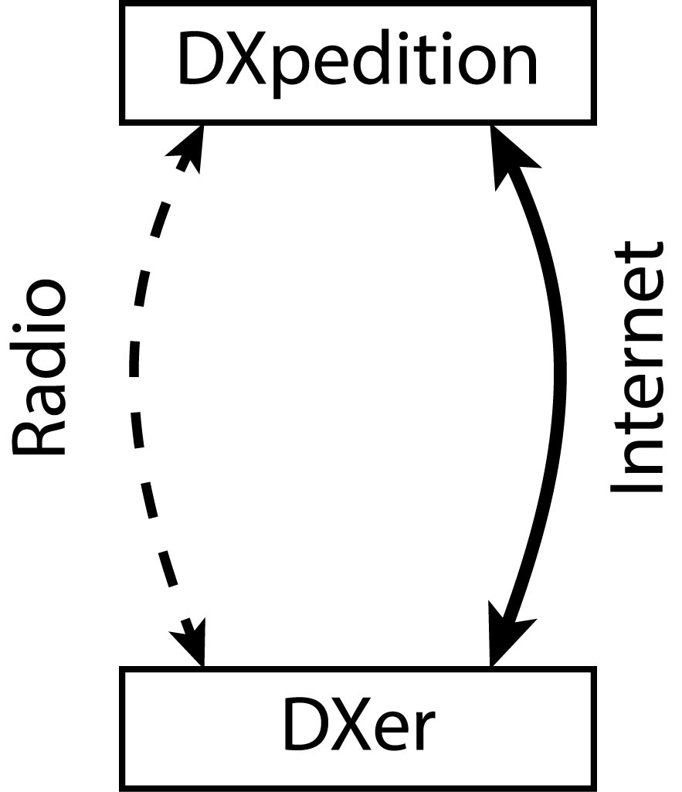
Introduction of the Internet
Applications
Online log server
Online logs
News
Automatic emails
Pre-emptive QSLs
Next-day QSLs

Slide 18
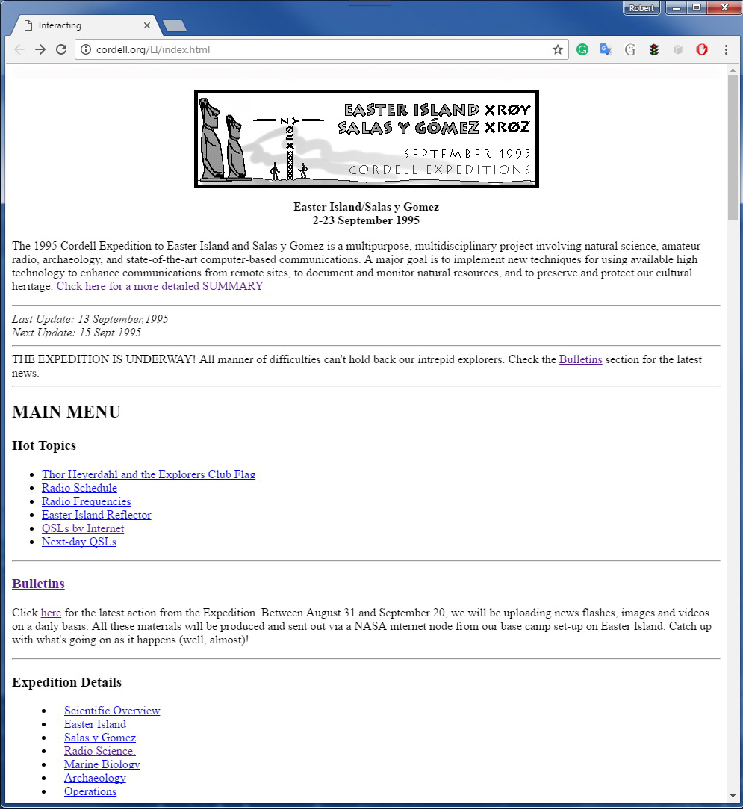
The First DXpedition Website

Slide 19
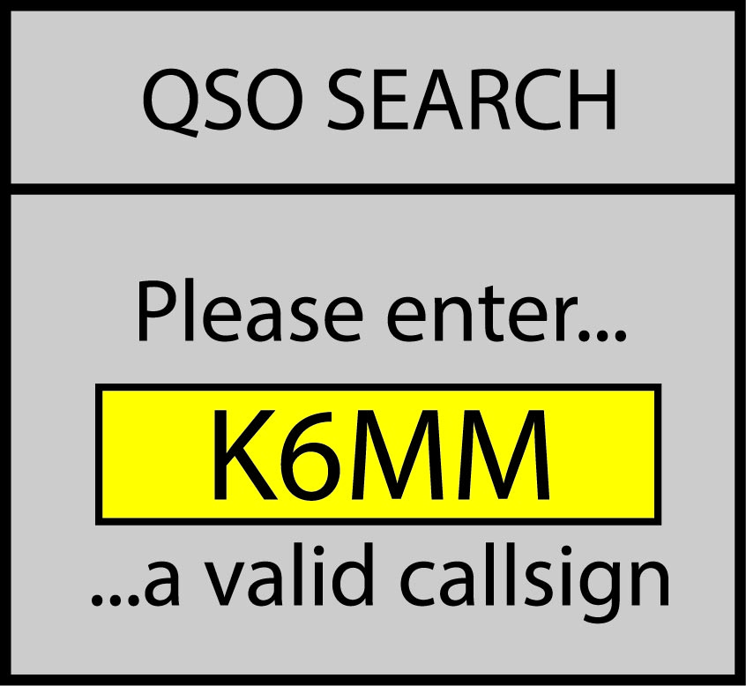
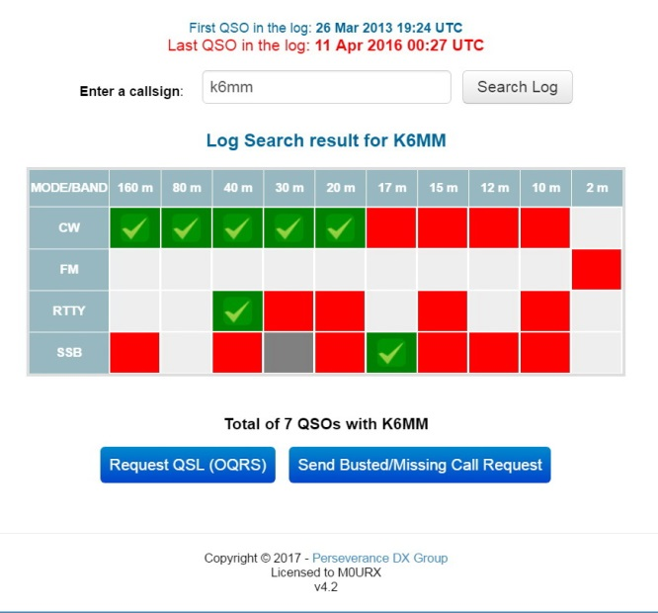
The Online Log Server
Robert Schmieder KK6EK

Slide 20
First use of the Internet on a DXpedition
Easter Island
1995

Slide 21
The Phases of DX
0
1
DX IS
INTERNET
XRØY
1995

Slide 22
PHASE 2 2005-2015 REAL-TIME
2

Slide 23
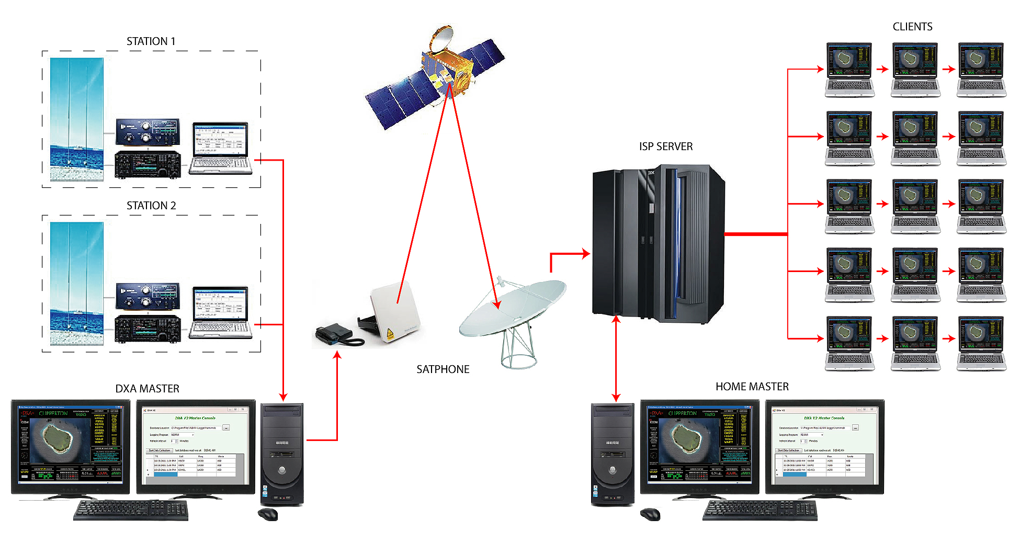
Real-time and graphics added to the Log Server)
DXpedition
DXA
Satellite
Internet
DXers
Notes:
The layout for DXA, the real-time online log server. The satellite most likely to be used is Inmarsat BGAN, although a new high-speed Ka mode has very recently become available that could enable real-time video.

Slide 24
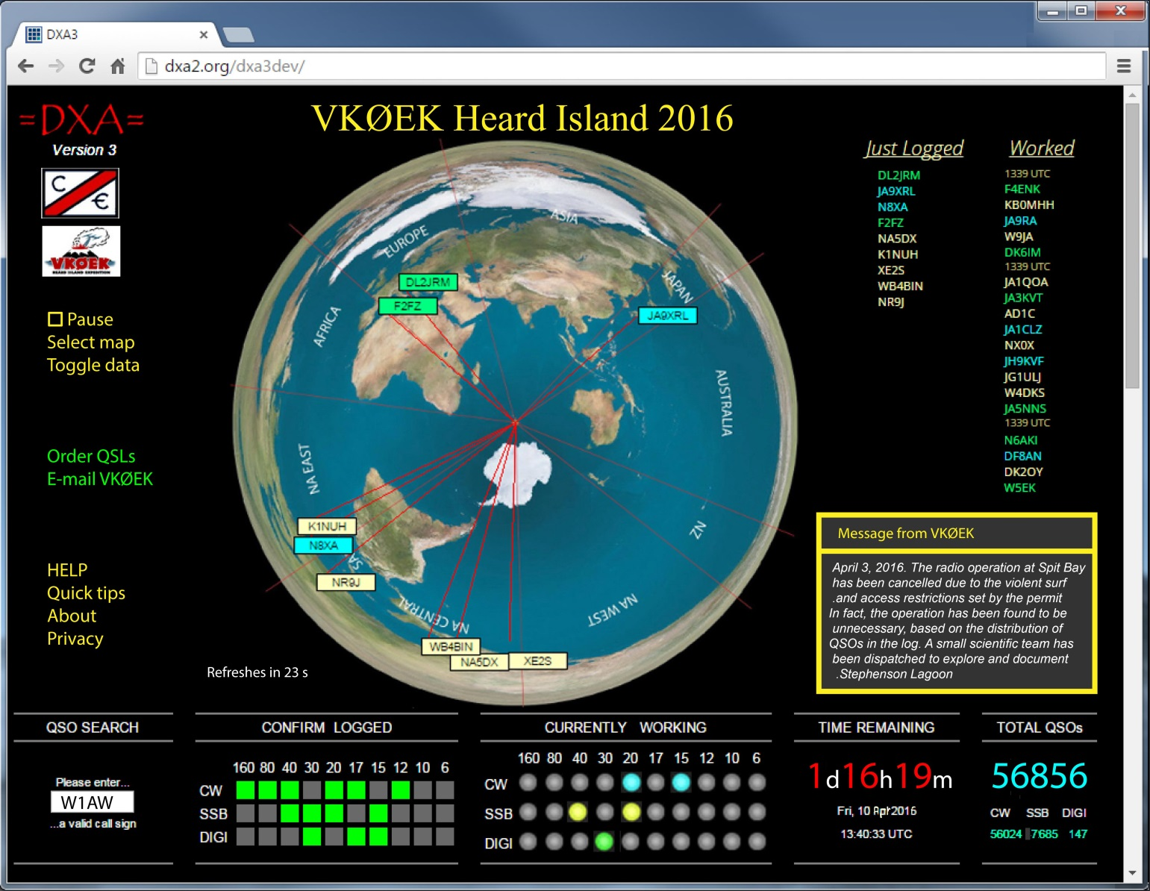
DXA – The Real-time Graphic Log Interface
Robert Schmieder KK6EK

Slide 25
What Real-time Brings to the DXpedition
Advantages
Immediate check of QSO in the log
Reduced dups
Elimination of pirates
Operating aid (watching active band-modes, etc.)
Pleasure in feeling part of the operation
Potential advantages
Coupling to other applications
Statistical displays
Quality monitoring of the DX station
DQRM reduction

Slide 26
Cost to Enable Real-time (DXA)
Rates
Terminal rental $10/day
Air time $7/MB
DXpedition
Rental 50 days $500
Data upload 5 MB
Total cost $535
[0.1% of Mega-DXpedition budget]

Slide 27
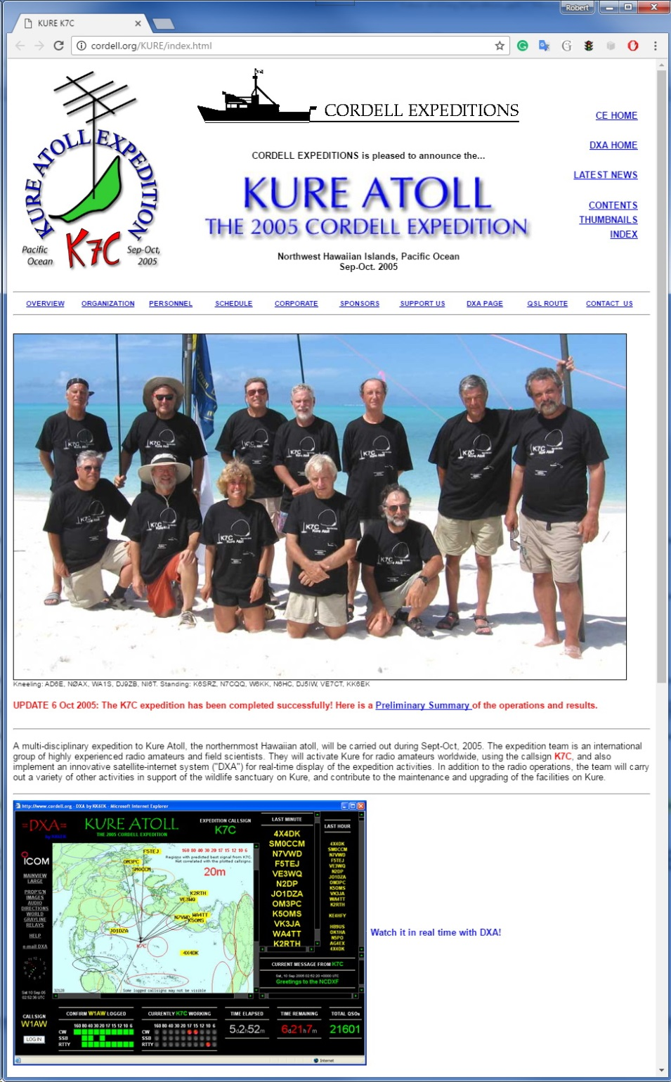
First Use of
Real-time Internet
Kure Atoll
K7C 2005
The online log server:
DXA

Slide 28
The Phases of DX
0
1
2
DX IS
INTERNET
REALTIME
XRØY
1995
K7C
2005

Slide 29
PHASE 3 2015-2025 SOCIAL MEDIA
3

Slide 30
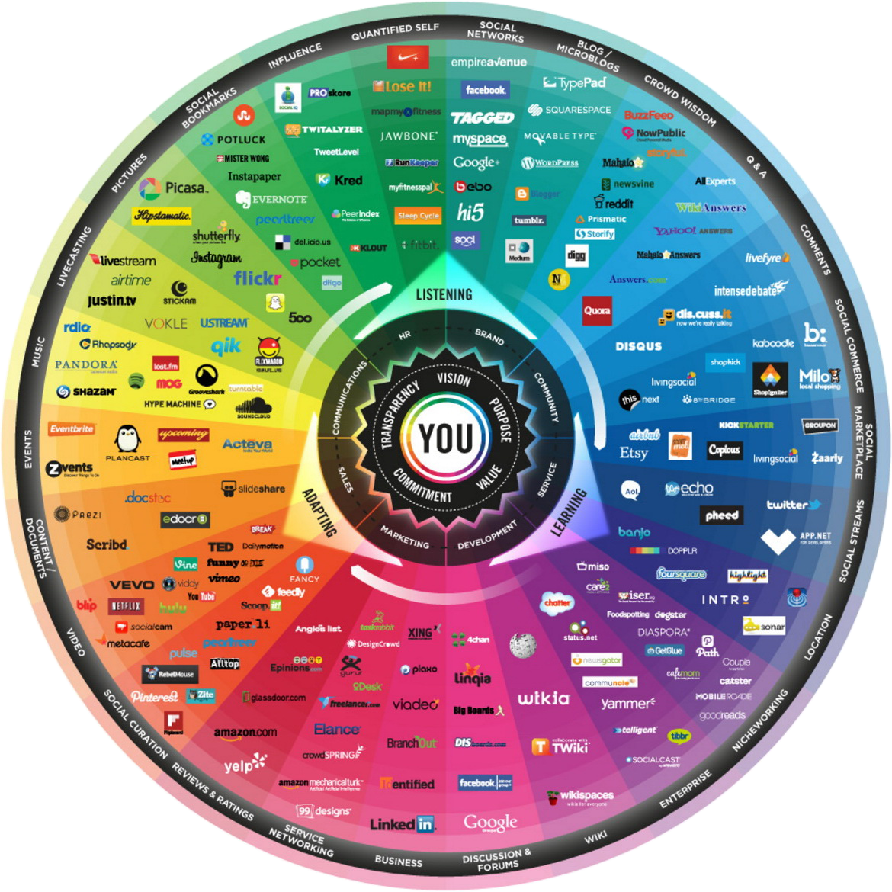
The Explosion of Social Media

Slide 31
Functions Enabled Through Social Media
DX websites
Email
Newsletters
Magazine articles
Blogs
Help Desk
AudioLog
Dropbox
Skype
YouTube
…and many more

Slide 32
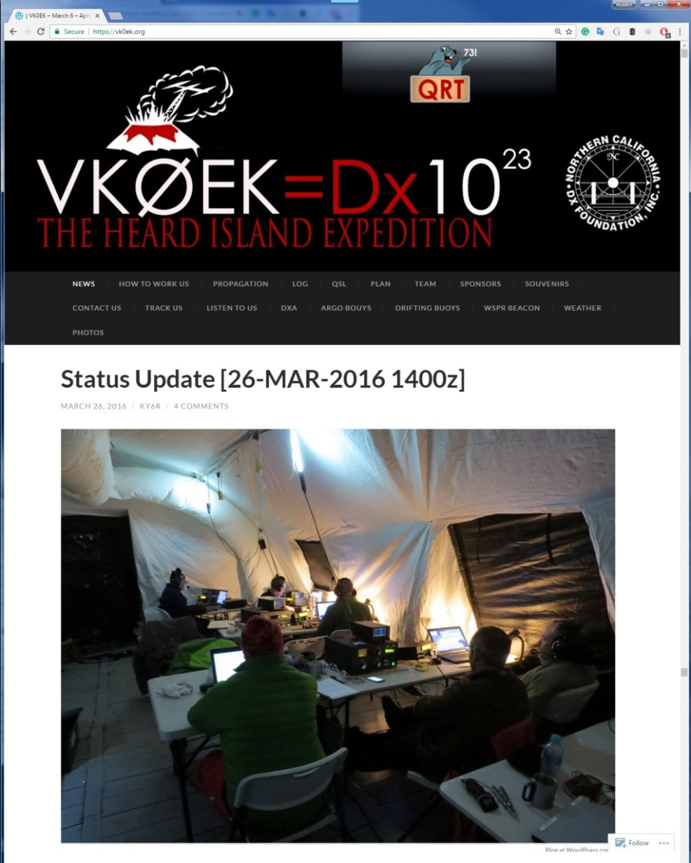
Example: Websites and Blogs
Heard Island VKØEK 2016
https://vk0ek.org/

Slide 33
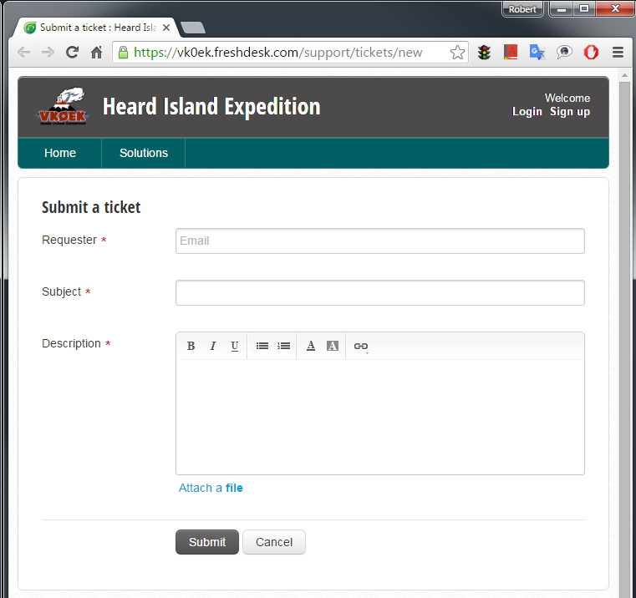
Example: Help Desk
Heard Island VKØEK 2016
Rich Holoch KY6R

Slide 34
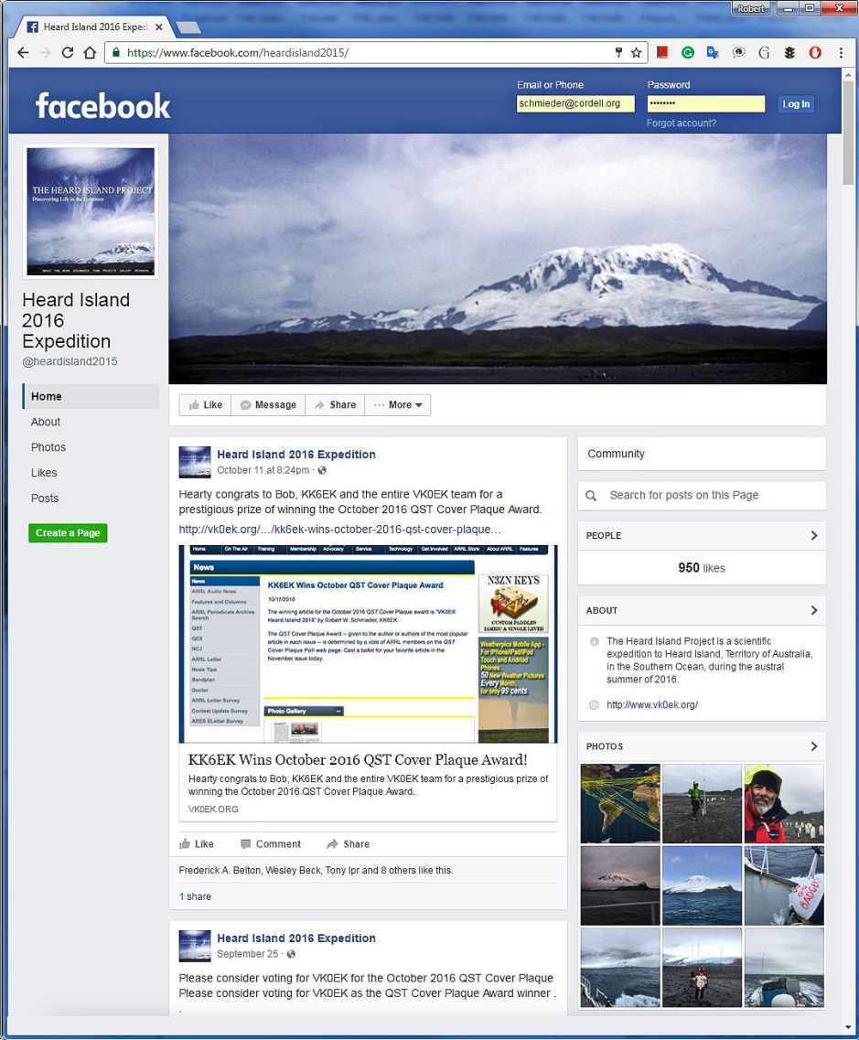
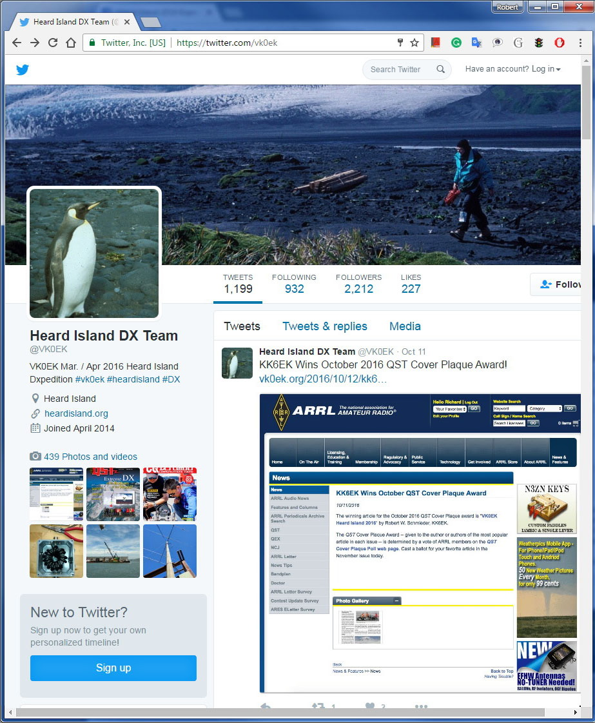
Facebook
Twitter

Slide 35
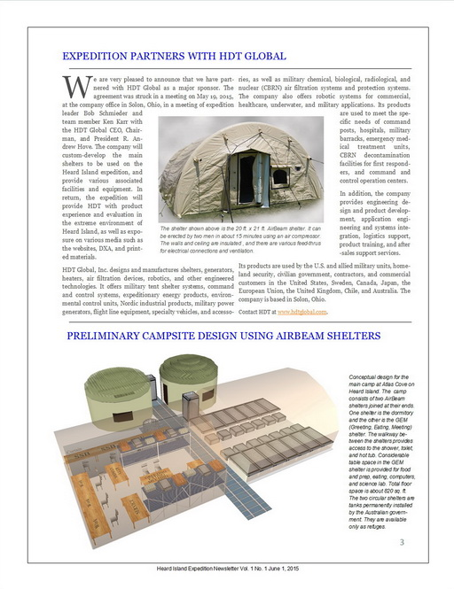
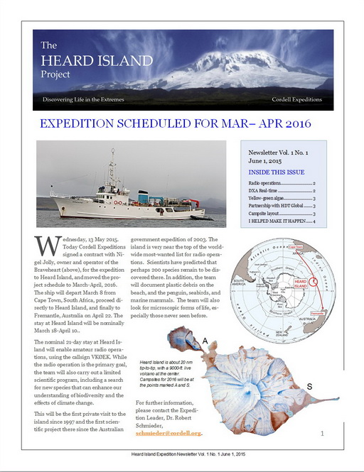
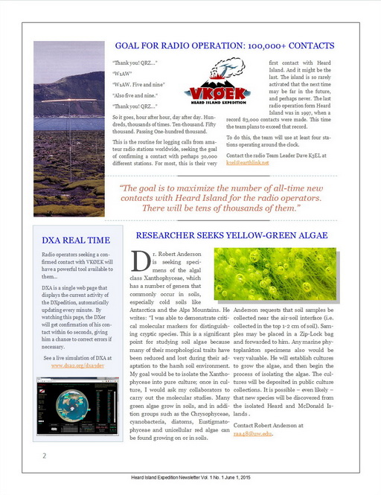
Example: Newsletter

Slide 36
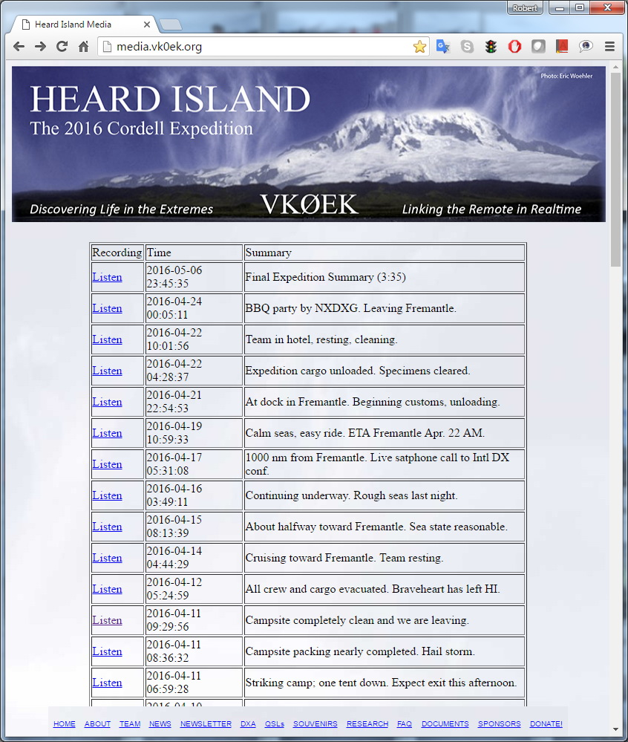
Example: AudioLog
Mike Coffey KJ4Z

Slide 37
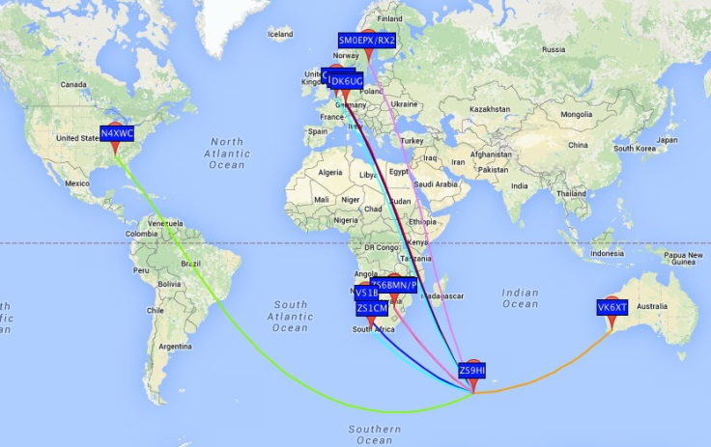
Example: Weak Signal Propagation Net (WSPR Net)
A group of amateur radio operators using very low power (QRP/QRPp) transmissions to measure radio propagation.
Adam Brown K2ARB

Slide 38
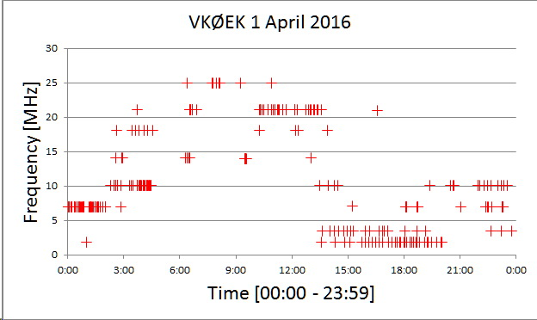
Example: Reverse Beacon Network (RBN)
A network of stations listening to the bands and reporting the stations they hear.
Adam Brown K2ARB

Slide 39
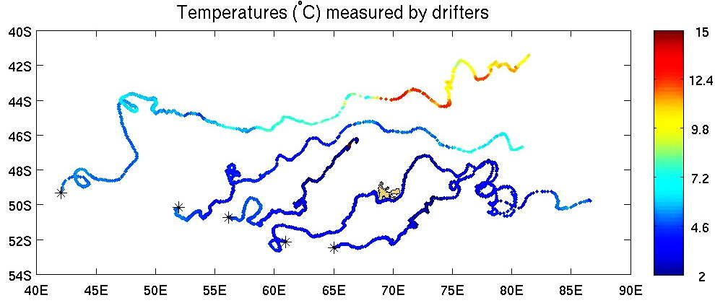
Example: Oceanic Drifters and Diving Buoys
A set of drifting and diving instruments provided by NOAA and WHOI that record and telemeter multiple oceanic parameters during many months of drifting after deployment. There are thousands of such instruments worldwide.
Adam Brown K2ARB

Slide 40
Internet Connections for VKØEK
)

Slide 41
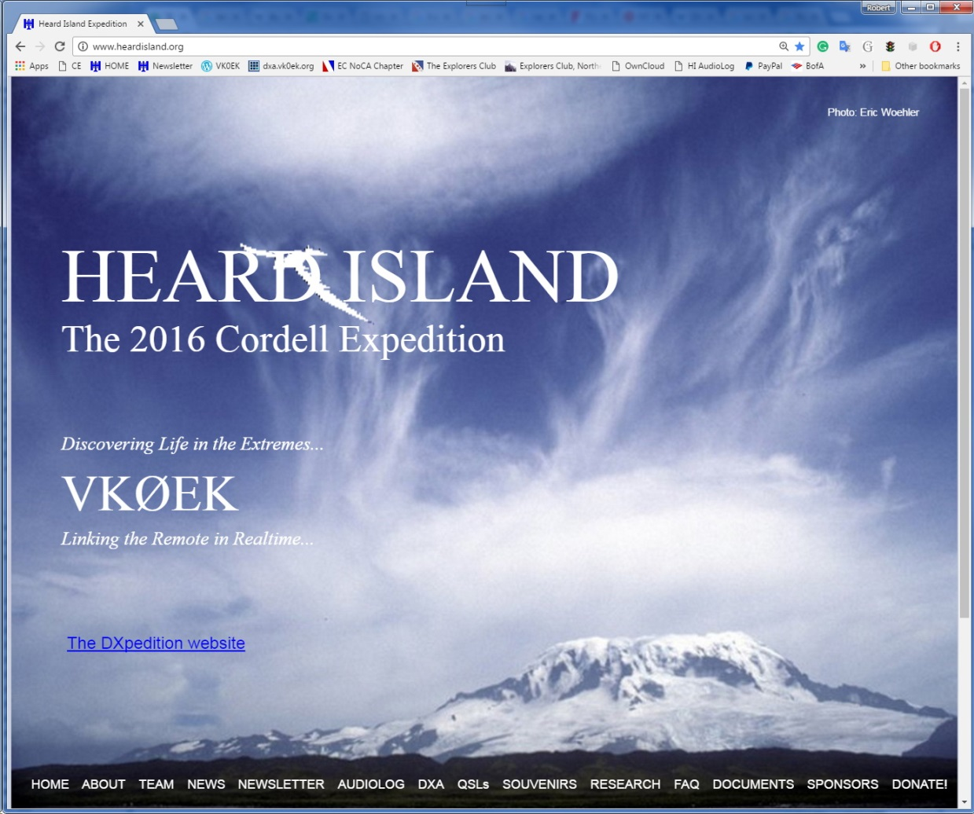
Advanced use of Social Media
Heard Island VKØEK 2016
www.heardisland.org

Slide 42
The Phases of DX
0
1
2
3
DX IS
INTERNET
REALTIME
SOC MEDIA
XRØY
1995
K7C
2005
VKØEK
2015

Slide 43
PHASE 4 2025-2030 SYSTEMS
4

Slide 44
Systems Engineering
Definition
“A branch of engineering which concentrates on the design and application of the whole as distinct from the parts.”
Parts
System

Slide 45
Components of DX Systems
Remote operation
Software-defined radio
New modes (e.g. JT65)
Adaptive signal processing
Automatic (unattended) logging
Integrated station operation
Signal optimization
Cooperative activities
Evolution of program rules (e.g., DXCC)
Event-wide optimization
Coordination with other activities
Active offsite team members
QSL operation

Slide 46
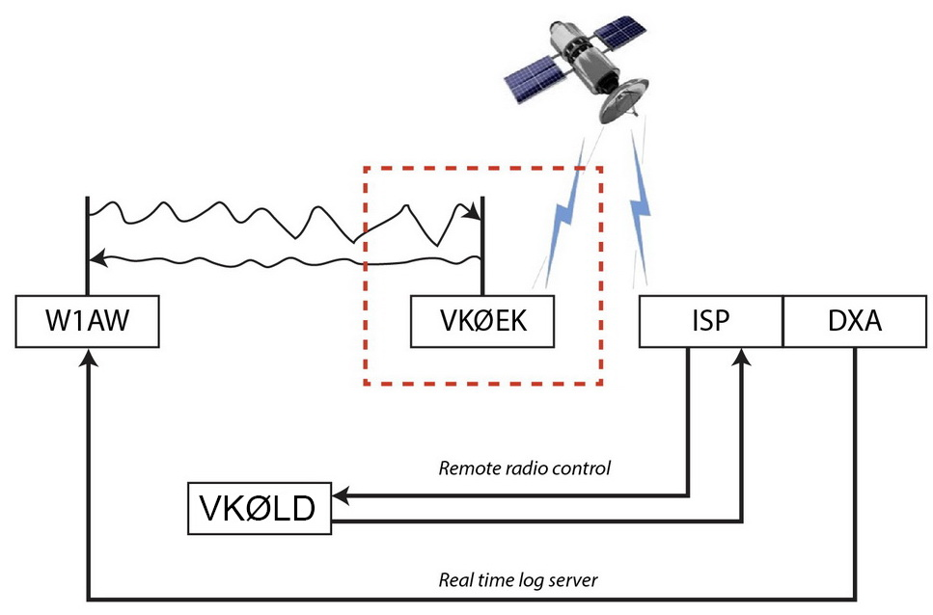
Example: Remote operation
Mike Coffey KJ4Z

Slide 47
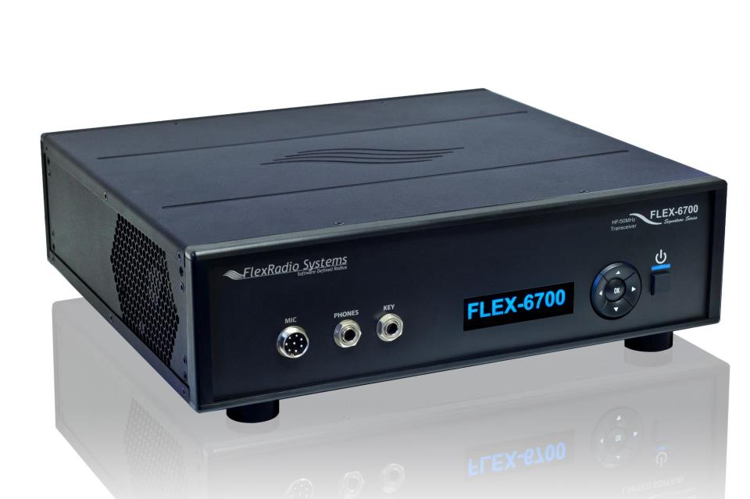
Example: Software-defined radio (SDR)

Slide 48
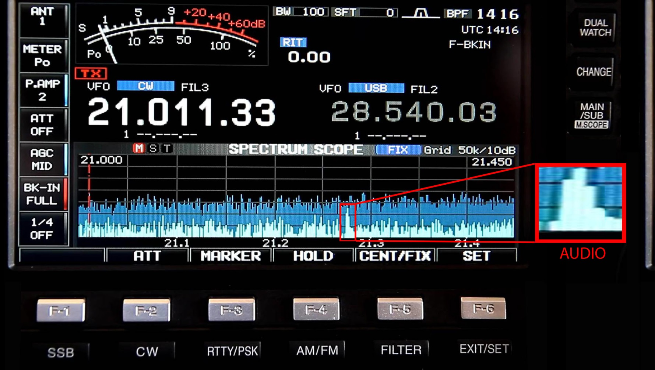
Example: Real-time auto-selection of best signal
Only the optimum signal fed to output

Slide 49
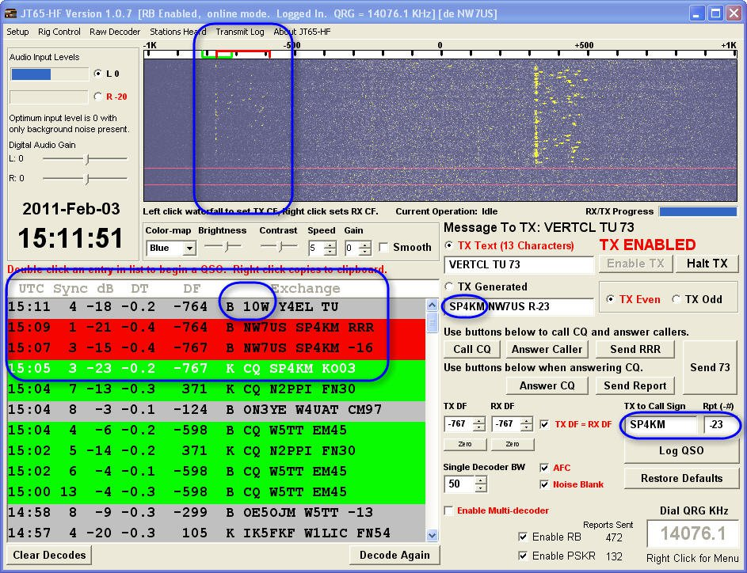
Example: New modes JT65

Slide 50
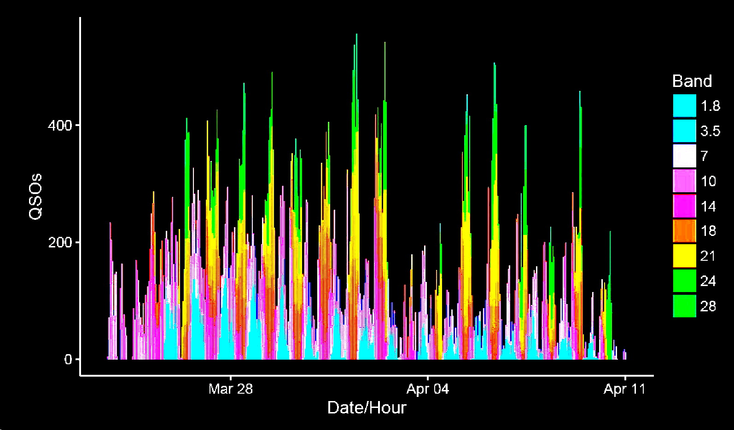
Example: Automatic compilation of signals

Slide 51
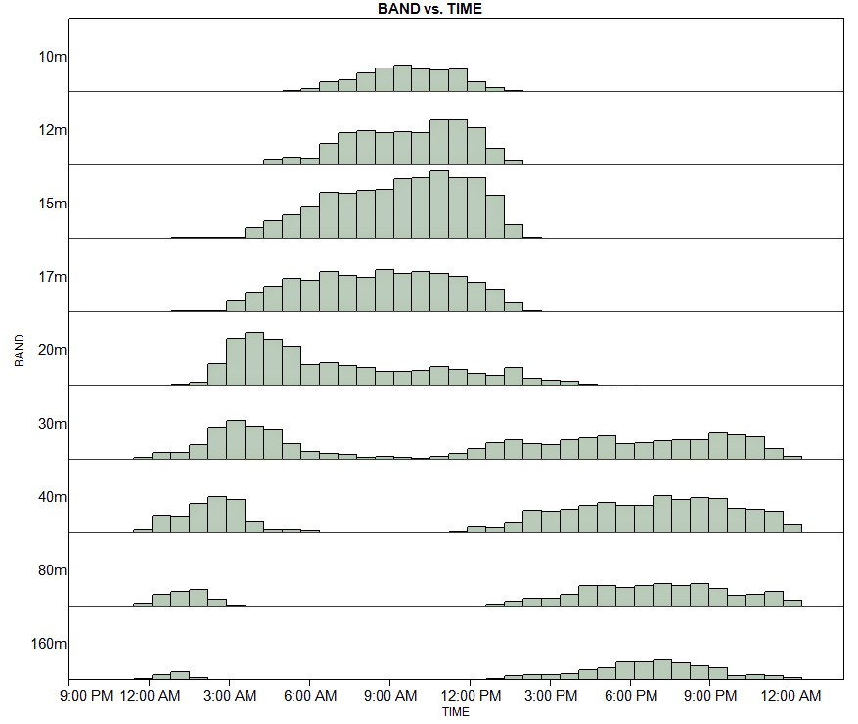
Example: Automatic statistical analysis of signals

Slide 52
COMPANIES
Example: Commercial sponsors

Slide 53
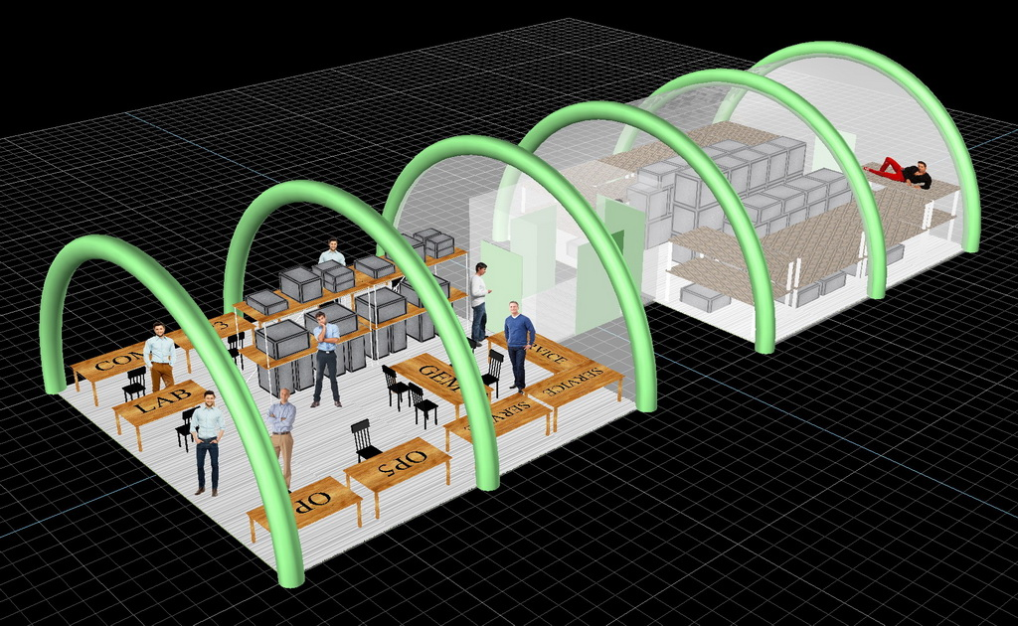
Example: The AIRBEAM Shelter
HDT Global

Slide 54
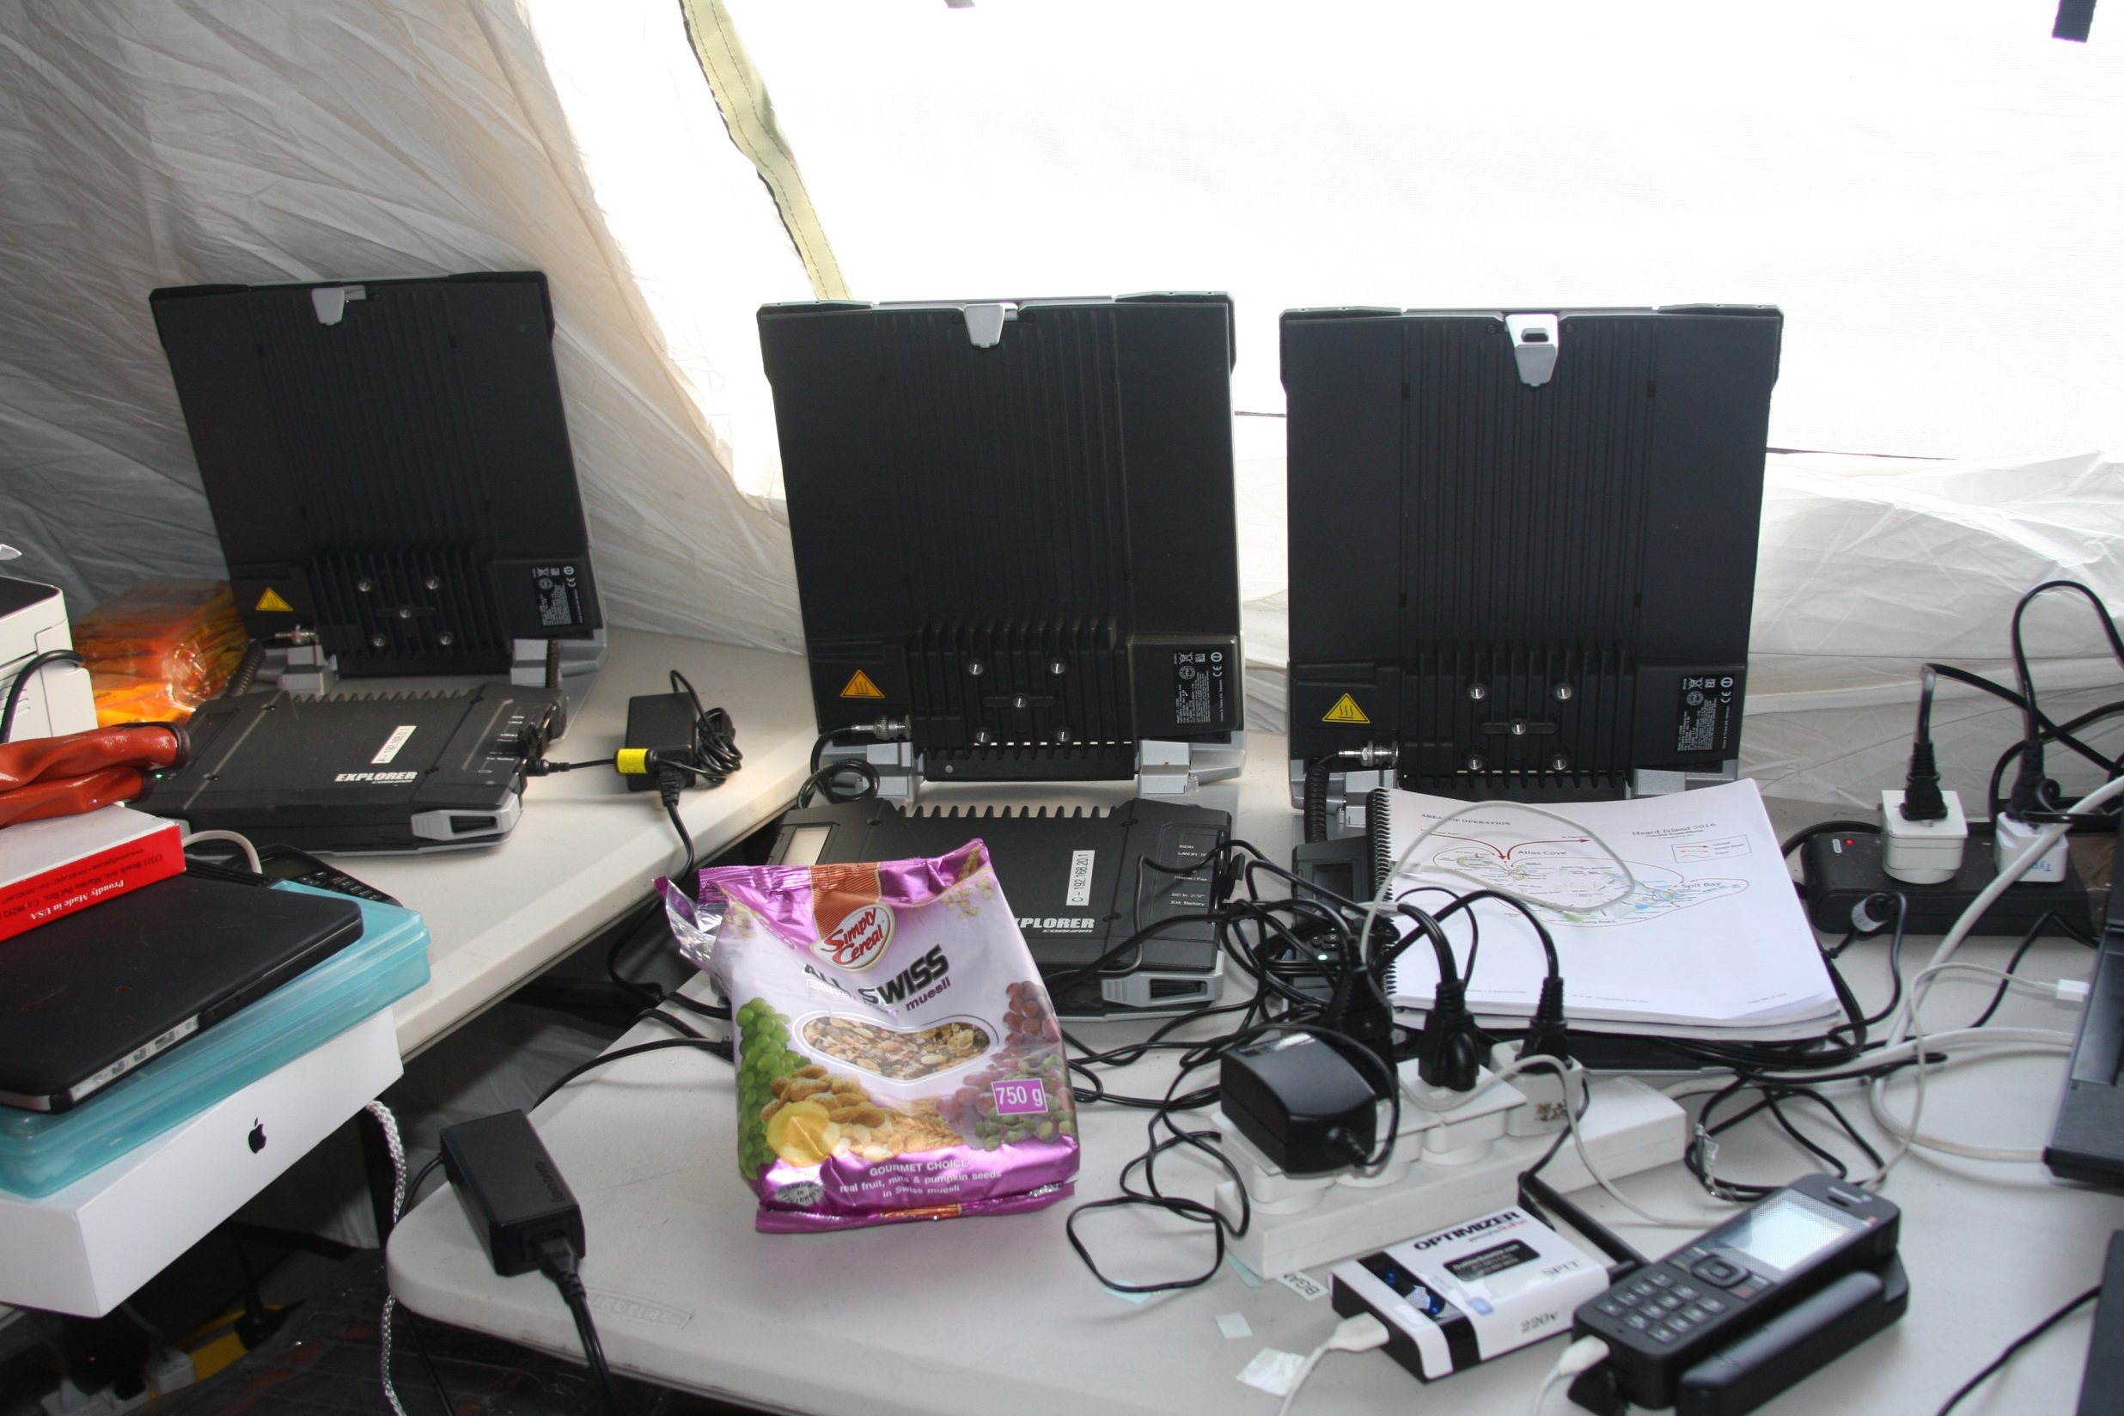
Example: Satellite terminals
Inmarsat BGAN
Terminals
Ken Karr NG2H

Slide 55
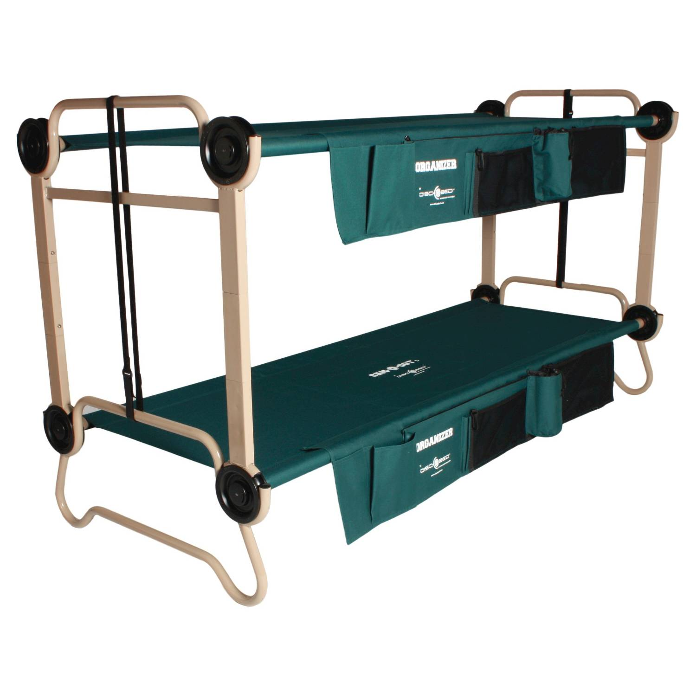
Example: Living facilities
Disc-O-Bed

Slide 56
Industries that can support DX
MANUFACTURING
Apparel
Chemical
Computer and Electronics
Electrical Equipment
Fabricated Metal
Food and Beverages
Furniture and Related
Machinery
Paper
Plastics and Rubber
SERVICE
Accommodation
Air Transport
Broadcasting
Construction
Data Processing
Electronics supply
Finance
Food Services
Health Care
Insurance
Internet Publishing and Broadcasting
Personal and Laundry Services
Postal Service
Printing and Related
Publishing
Rental and Leasing
Scenic and Sightseeing Transportation
Telecommunications
Transit and Ground Transport
Warehousing
Warehousing and Storage
DISTRIBUTION
Building Material and Garden Equipment
Clothing
Electronics and Appliances
Food and Beverages
Furniture and Furnishings
Gasoline and Fuel
Motion Picture and Sound Recording
Motor Vehicle and Parts
Sporting Goods, Hobbies, Books, and Music

Slide 57
Procedural aspects of Systems Engineering
Requirements definition
Design
Coordination
Logistics
Reliability
Evaluation
Risk management
Testing
Maintainability

Slide 58
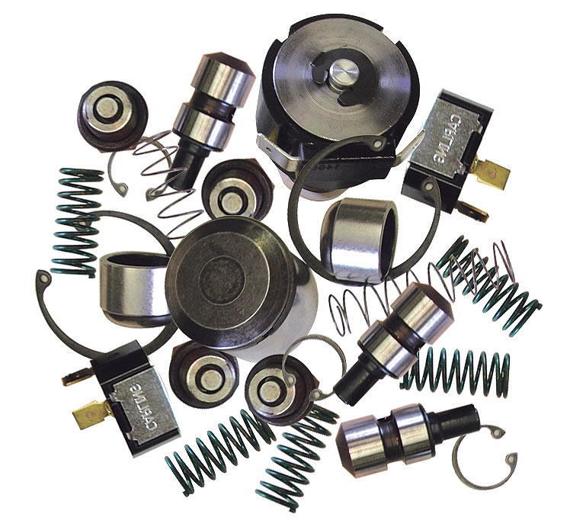
Any collection of parts can be a System

Slide 59
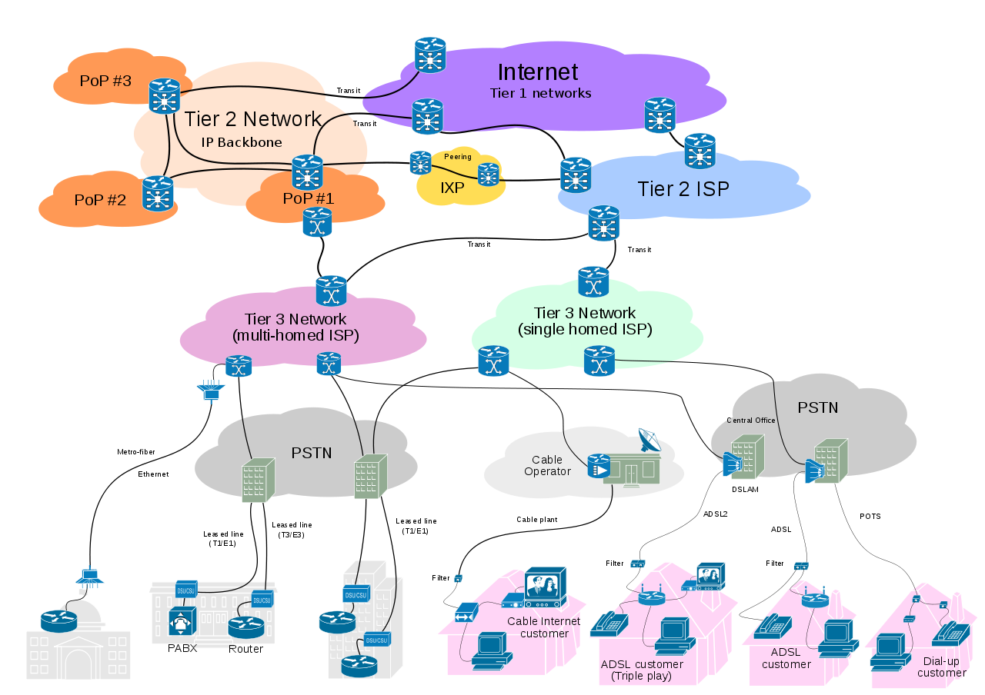
Systems Design is done with Graphs

Slide 60
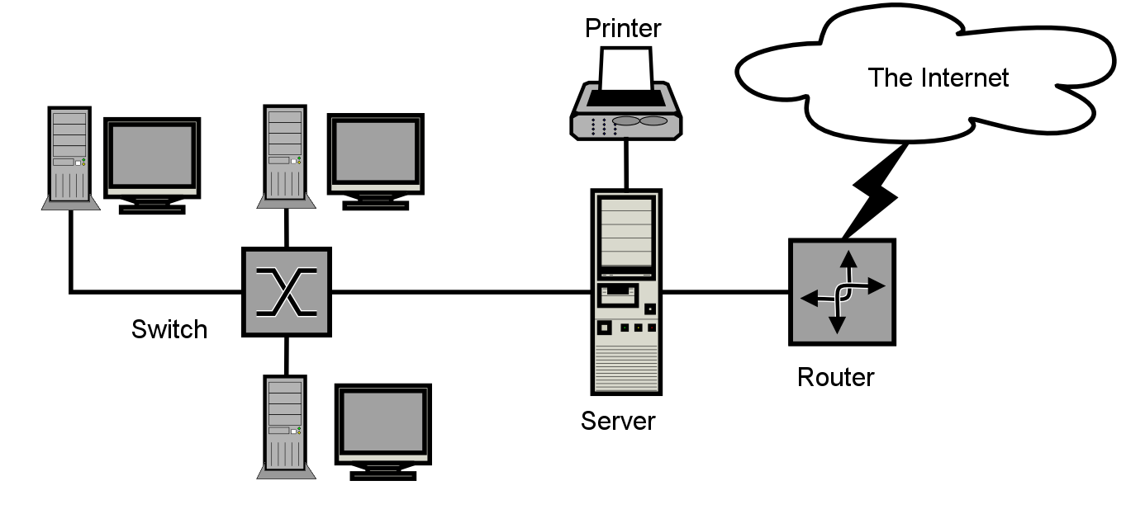
Example: Network Diagram

Slide 61
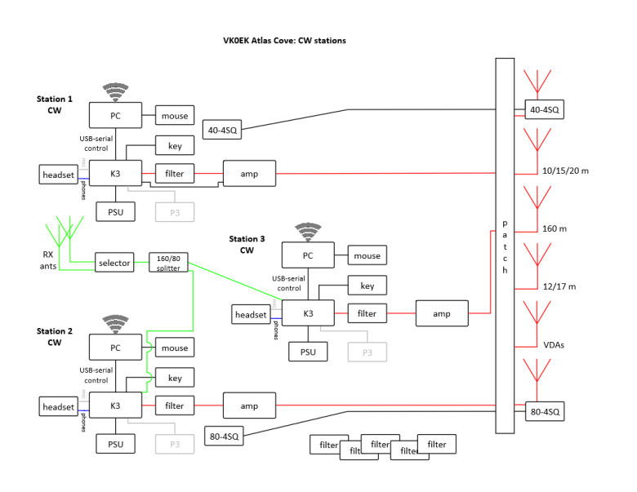
Heard Island CW Stations
(Example of a Network Diagram)
Notes:
Block diagram of the VKØEK stations. At Atlas Cove there are nominally 4 stations, with 2 backups. At Spit Bay there will be another 2 stations.

Slide 62
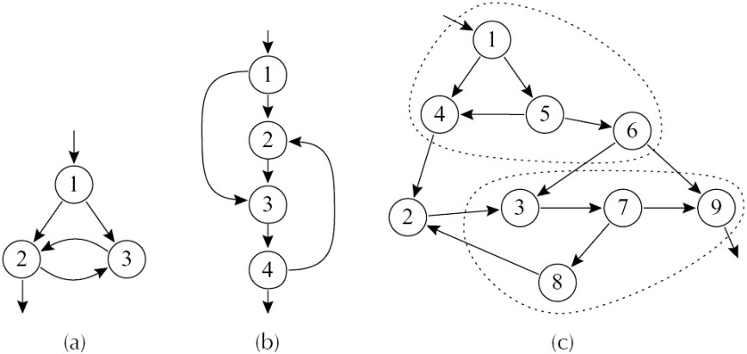
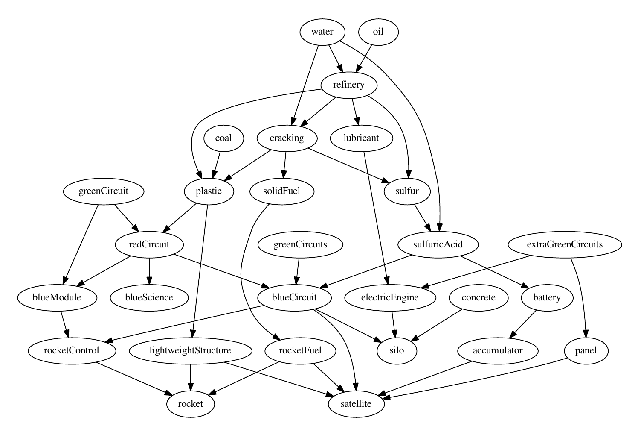
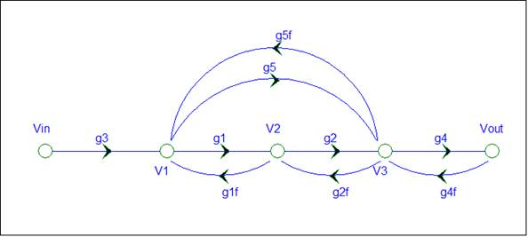
Example: Flowgraphs

Slide 63
QSL Processing Procedure
(Example of a Flowgraph)

Slide 64
Example: Architectural Interconnect Diagram

Slide 65
DX Station Connection Diagram
(Example of an Architectural Interconnect Diagram)

Slide 66
DX as a System
SYSTEM = {Part 1, Part 2}
Part 1 = DXer
Part 2 = DXpedition
SYSTEM = {DXer, DXpedition} ≡ DX

Slide 67
“DX” defines a System
DXer
DXpedition
Person
Operator
Spouse
Family
Interrupters
Equipment
Radio
Amplifier
Antenna
Power
Logging
Program
Goals
Rules
Monitoring
Procedures
Operating
Optimization
Limits
DXpeditioners
Motivation
Availability
Experience
Quality
Compatibility
Equipment
Radios
Amplifiers
Computers
Antennas
Cabling
Internet
Shelters
Food
Water
Generators
Containers
Safety
Transportation
Vessel
Transport
Personal
Coordination
Financial
Budget
Fundraising
Donors
Sponsors
Contingency
Legal
Permits
Insurance
Contracts
Outreach
Websites
Service
Tracking
Operations
Operating
Other activities
Health
Recordkeeping
Planning
Meeting
Online conferences
Presentations
Post-expedition
DX =

Slide 68
DX as a Connectivity Diagram
DXpedition
DXer

Slide 69
Optimizing the Connectivity Diagram
Sensitivity
Measures
Optimum

Slide 70
Who will do the Systems Engineering?
Young computer nerds
Tech-savvy amateurs
Professional developers
Senior advisors
Systems Engineering will be both
Necessary and Sufficient
…until the next Phase!

Slide 71
Extensive Use of Systems Engineering
Who?
When?
What?
How?

Slide 72
The Phases of DX
0
1
2
3
4
DX IS
INTERNET
REALTIME
SOC MEDIA
SYSTEMS
XRØY
1995
K7C
2005
VKØEK
2015
???
2025

Slide 73
PHASE 5 2030+ SOCIETY, EARTH,
TECHNOLOGY
5

Slide 74
The BIG Question
What will DX be in 25 years?
Relevance to social concerns
Integration with other programs
Promoting causes or activities
Analogous activities
Space program
Sports events
Auto races

Slide 75
The Devaluation of Distance
Distance as an issue is devalued:
DX → X
The future of DXing and DXpeditions
Society (S)
Earth (E)
Technology (T)
X ≡ {S,E,T} ≡ SET
X =

Slide 76
What to think about
Combining DX with promoting causes
Administration of justice
Climate change
Disadvantaged persons
Energy supply
Health care
Natural resources
Pandemics
Poverty and malnutrition
Preservation of history
Racial issues
Scientific research
Stability of government
Wildlife protection
World peace

Slide 77
The Phases of DX
0
1
2
3
4
5
DX IS
INTERNET
REALTIME
SOC MEDIA
SYSTEMS
SET
XRØY
1995
K7C
2005
VKØEK
2015
???
2025
???
2030

Slide 78
YOUR PART IN THE FUTURE OF DX

Slide 79
The (New) Principle and Definition of DX
The (20th Century) Fundamental Principle:
The DXpedition is a performance for the DXers
The (21st Century) Reality:
What DXers want: Callsigns in the log
What DXpeditioners want: Callsigns in the log
DXers and DXpeditioners want the same thing!
→ The (21st Century) Fundamental Principle:
DX is a cooperative activity involving a single team:
DX = DXpedition + DXer

Slide 80
Staircase Diagram of DX
Flight ≡ The Components of DX
(Radios, QSLs, Satellites, etc.)
Landing ≡ DX Phase Transition
(e.g., Real-time → Systems)
2025-2030
5
4
2030+
2005-2015
3
2
2015-2025
1915-1995
1
0
1995-2005

Slide 81
Summary of the Phases of DX
Phase 0 1915-1995 DX IS!
Phase 1 1995-2005 Internet
Phase 2 2005-2015 Real-time
Phase 3 2015-2025 Social Media
Phase 4 2025-2030 Systems
Phase 5 2030+ Society,Earth,Technology (SET)
You are here
0
1
2
3
4
5
DX IS
INTERNET
REAL-TIME
SOC MEDIA
SYSTEMS
SET

Slide 82
ü
The Big Choice for DX persons
Stay in the 20th Century
Find a rich person and be happy
Complain and criticize
Drop out
Embrace technology
Think Internet, Real-time, Systems
ü
A few recommendations…

Slide 83
What DXpeditioners should do
→ Designate a Systems Manager
for the DXpedition
DXpedition Systems Manager
Onsite
Expedition Leader
Radio Team Leader
Logistics Manager
Safety Officer
Onsite Systems Mgr
Offsite
Social Media Manager
QSL Manager
Local Team Managers
Financial Officer
Offsite Systems Mgr

Slide 84
What DXers should do
→ Create your own Systems Manager
for the Event
Event Systems Manager
In the shack
DXer
Event participant
Equipment
Supplies…
Out of the shack
Family
Office colleagues
DXing community
Internet…

Slide 85
What the DX Special Interests should do
DX clubs, organizations, foundations
Define policies that apply to DX Systems
Magazines (DX Magazine, QST, etc.)
Solicit articles on DX Systems
Companies
Incorporate DX Systems advantages in your products
Entrepreneurs
Development of Real-time DX systems
Software tools for designing DX Systems
Services to DX based on DX Systems
Commercial
Opportunities!

Slide 86
What Everyone should do
→ “Think Systems!”
DX System
DXpedition Support
DXer
Support
DXpedition Team
Satellite
DXer
Radio
Waves
DXpedition
Site
DXer
Shack
DXpedition System
DXer System

Slide 87
What Everyone should do
→ Get ready to “Think SET!”
SOCIETY
EARTH
TECHNOLOGY

Slide 88
The Future of DX
SOCIETY EARTH TECHNOLOGY
SET

